Slide 1
NETFLIX MOVIE
RECOMMENDATION SYSTEM
Siddhi Bhor - 19101B2010 Purva Lokare - 19101B2007

Slide 2
What is Recommendation Model?
A recommendation model, in simple terms, is an algorithm that aims to provide the most relevant and relatable information to a user depending on the behavior of the user.

Slide 3
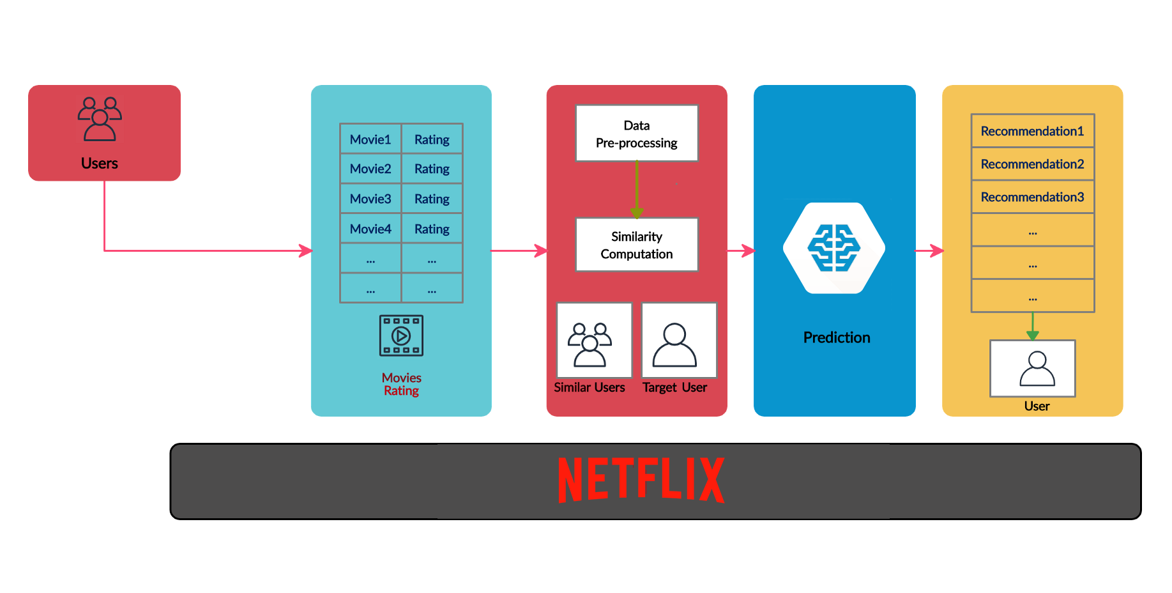
Methodology

Slide 4



Graphs
Libraries
Bar graph Scatter Plot Heatmap
Ggplot Recommenderlab Data.table reshape2

Slide 5
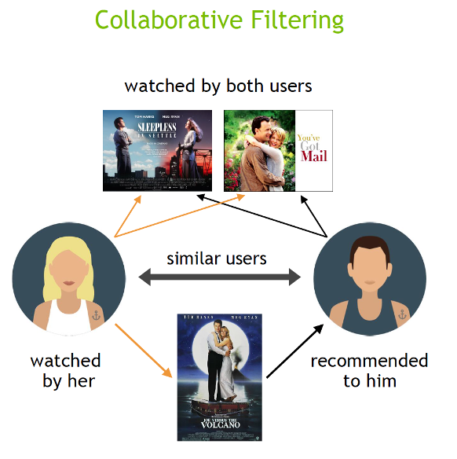
Algorithm Used
Collaborative Filtering
collaborative filtering is the process of predicting a user's preference by studying their activity to derive patterns.
For example, by studying the likes, dislikes, skips and views, a recommender system can predict what a user likes and what they dislike.
K means clustering
k means clustering method to split the object in the dataset into clusters. A class label will be attached to the clusters for matching based on the user input

Slide 6
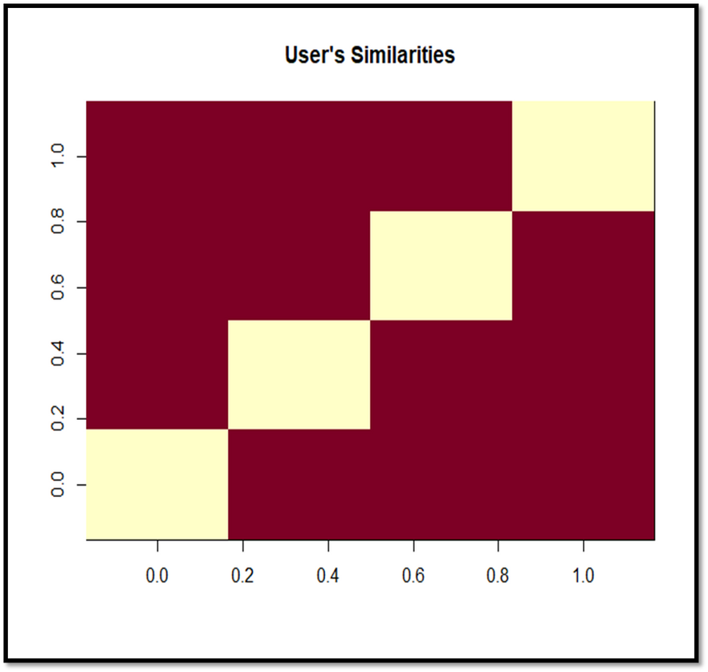
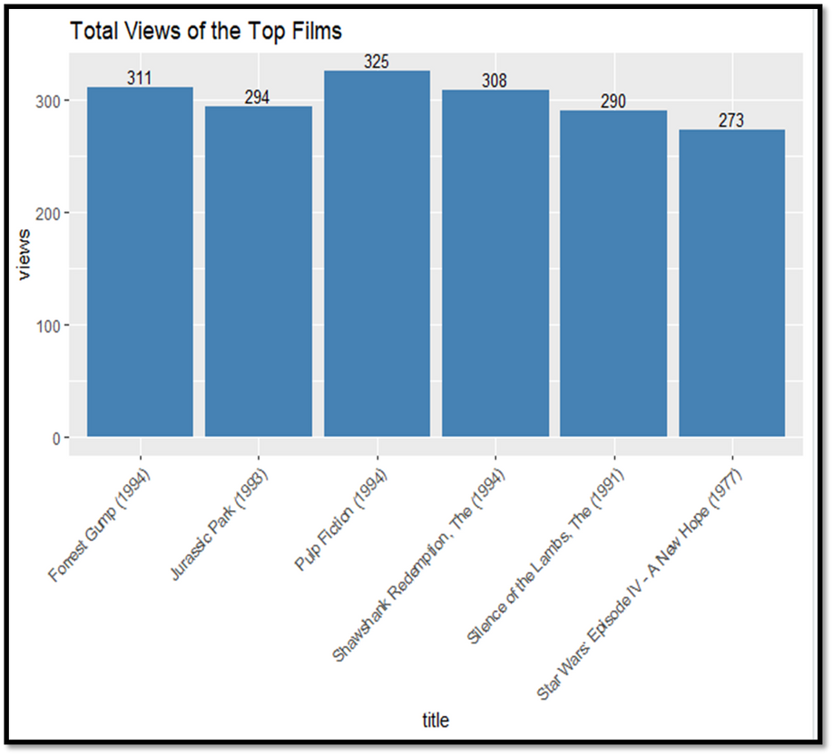
Results

Slide 7
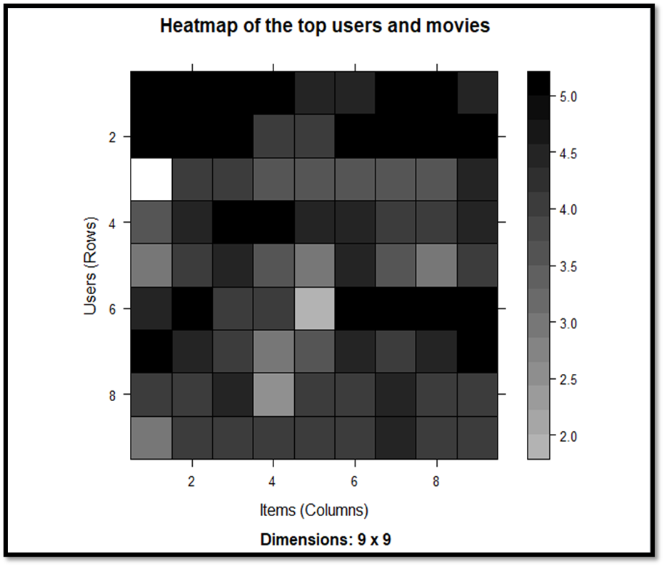
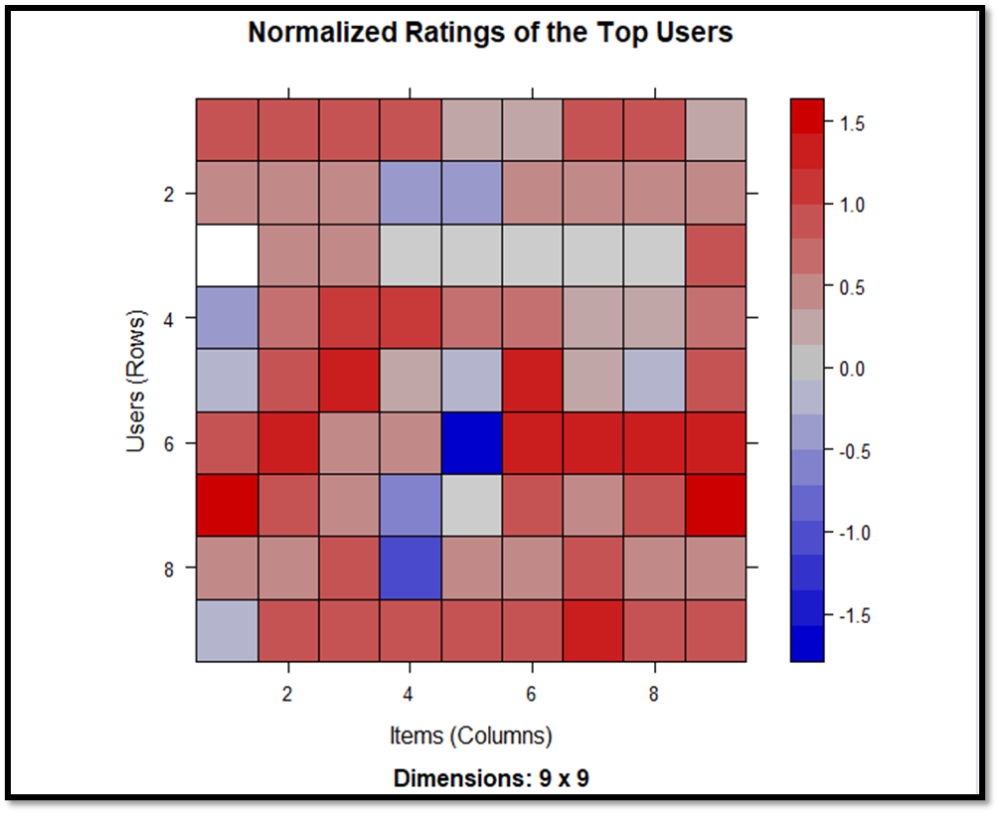
Results

Slide 8
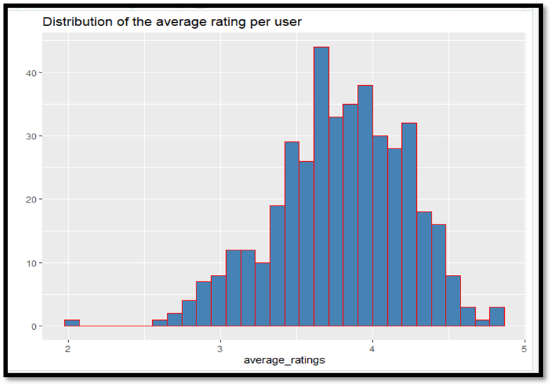
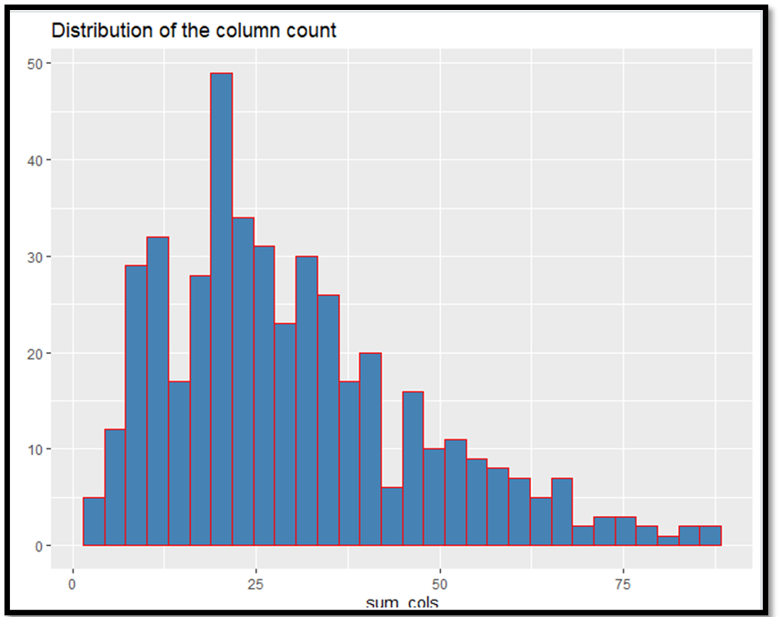
Results

Slide 9
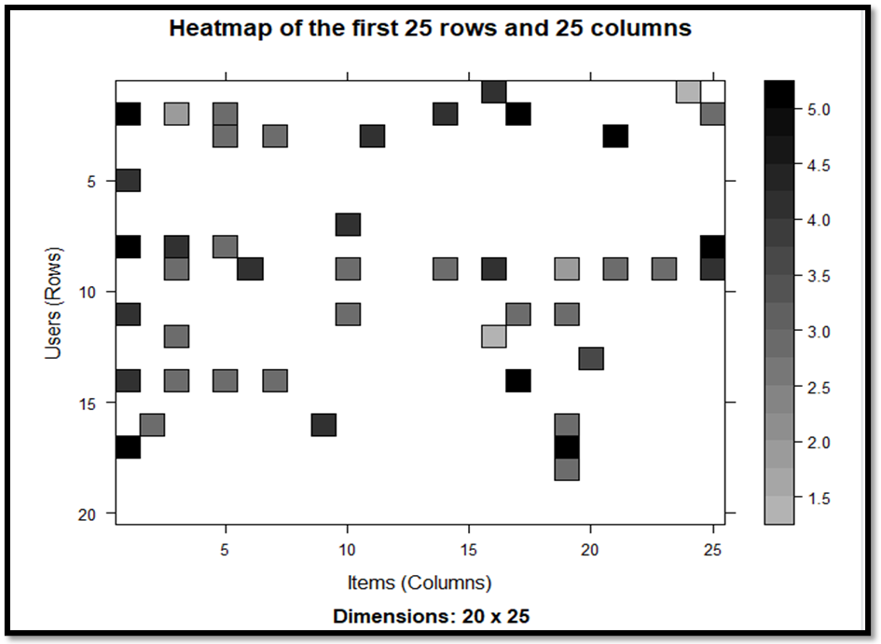
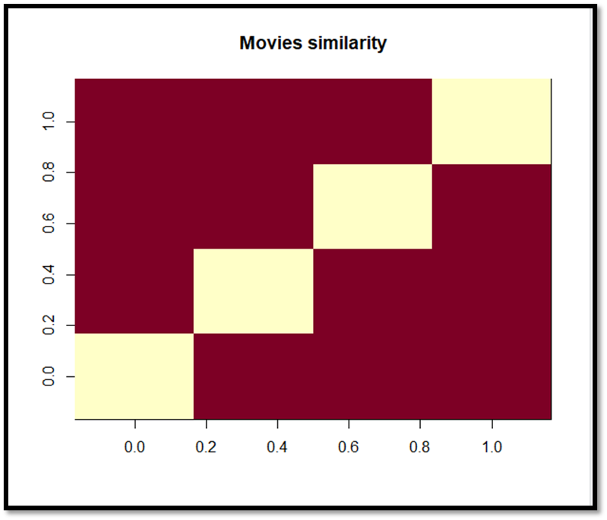
Results

Slide 10
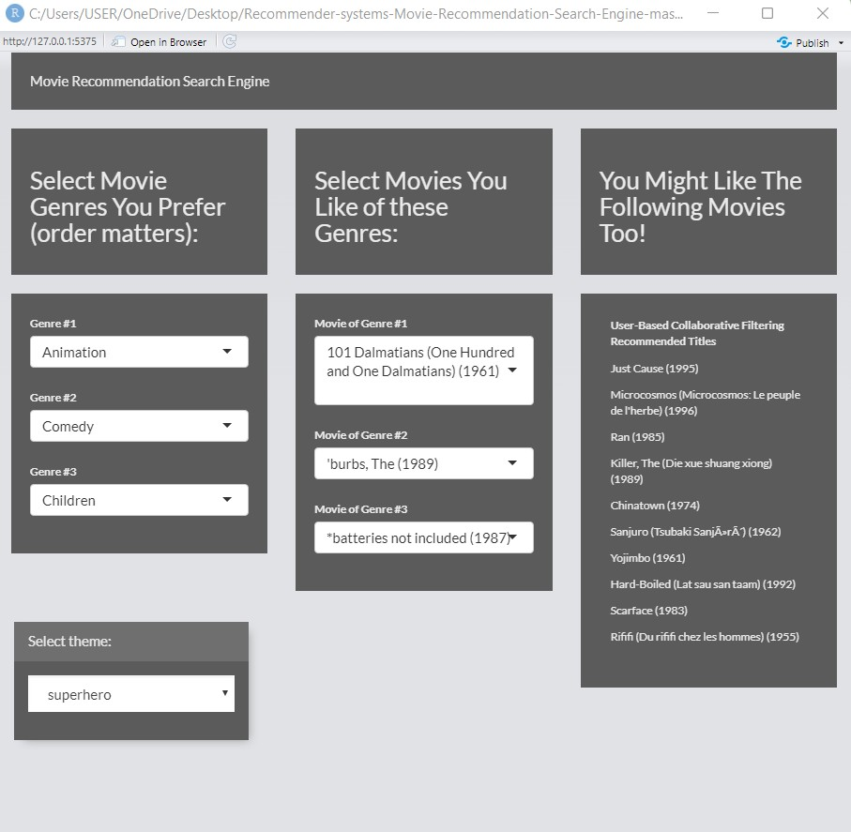
UI Integration

Slide 11
Thank You

